Slide 1

LA French Tech Beyrouth
Presentation
Bdk thki 3an el web site lesh 3mlto w lmin

Slide 2




demo
process
About French tech
challenges

Slide 3

About French tech
*Some Clarifications*
What is the MARKETING purpose of Ohana Development ?
Type of content ?

Slide 4
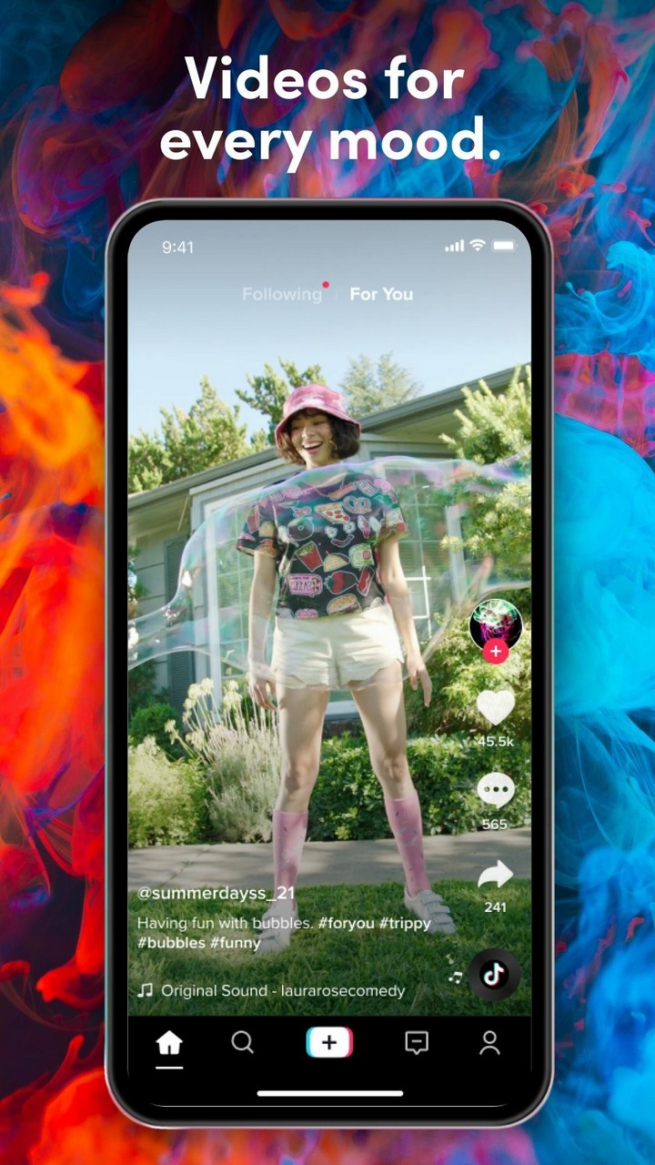
Process
1. Uml Diagram
Use case visitors
Use case admin
One sequence for visitor
One sequence for admin
2. Create Server
Http server
Middleware
3. Data base
Schemas
Controllers
Routing
4. Testing
Postman

Slide 5
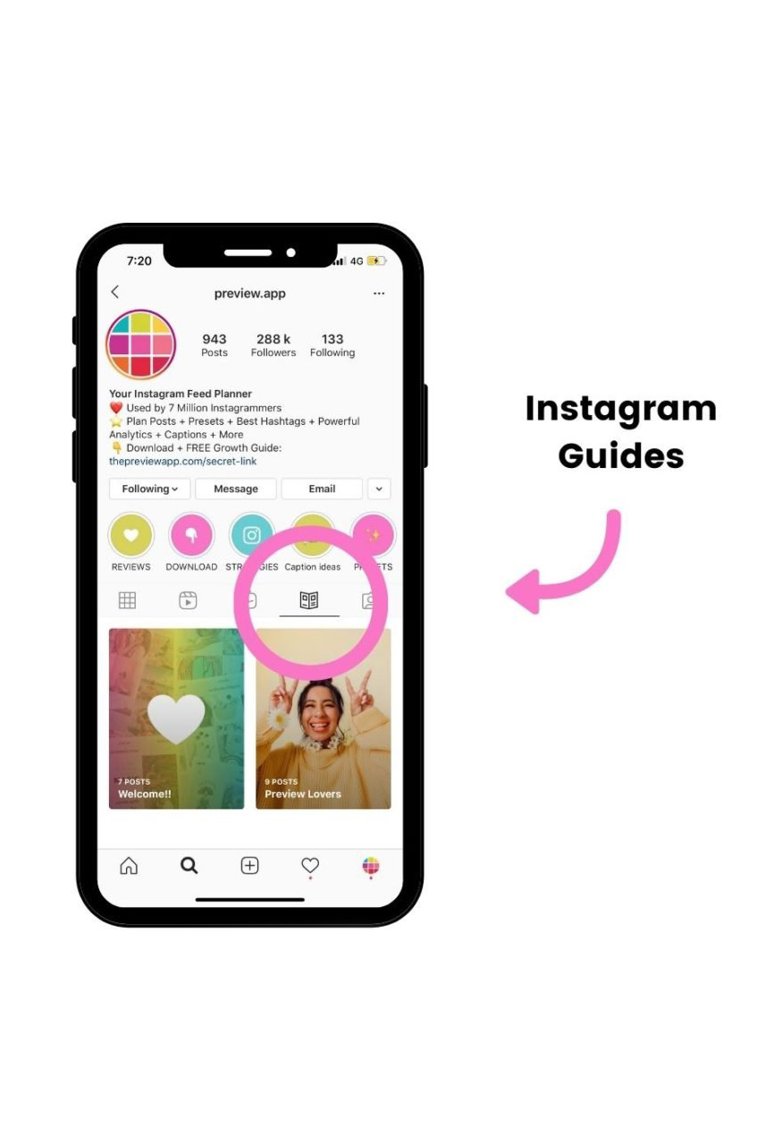
Process
Front end package:
"dompurify"
"draft-js"
"flag-icons“
"framer-motion“
"gsap"
"i18next"
"js-cookie“
"react-awesome-slider“
"react-icons“
"react-intersection-observer“
"react-parallax“
"react-player“
"react-pro-sidebar":
"react-router-dom":
"react-scroll"
"styled-components"

Slide 6
?
Content Road Map
1) Research other people’s Content
75% trends & 25% evergreen videos
2) Research our HASHTAGS
Between 100 k – 2 millions views
3) Publication Schedule
Posting 2-3 videos per week on tiktok and insta reel
Daily Stories on insta/fb
Monthly videos on insta/fb ( campaign uses )
WHAT OPTIONS do we need ?
4) Account Authority
The platform’s algorithm highly affects the profile by:
The first five videos
Theme uniformity and consistency
View tiers (Engagement, video loop…)

Slide 7

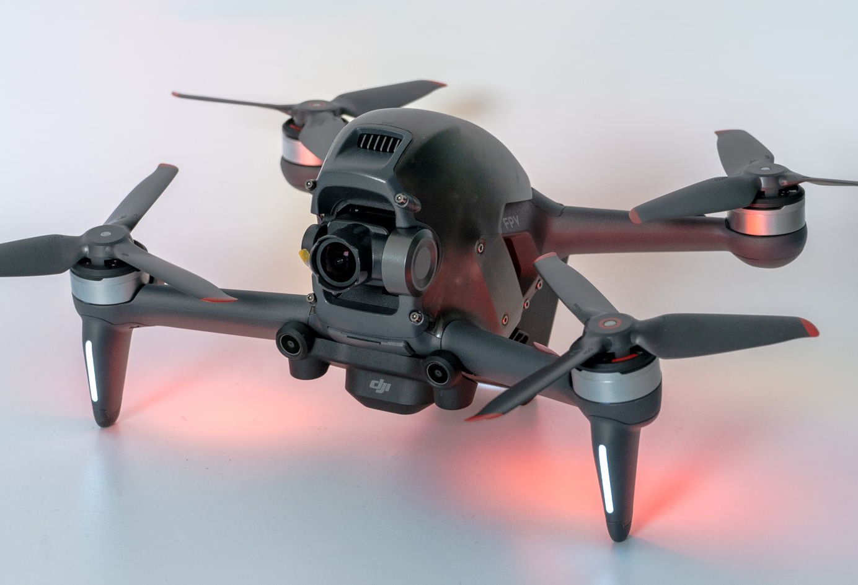
Account Quality
Preserving consistency for each platform
Picking the right time for posting
Posting daily stories to keep the accounts active
Image quality is important to attract the audience with magnificent shots and to beautifully express the details of any given villa during day and night. (In low light and high light conditions)

Slide 8
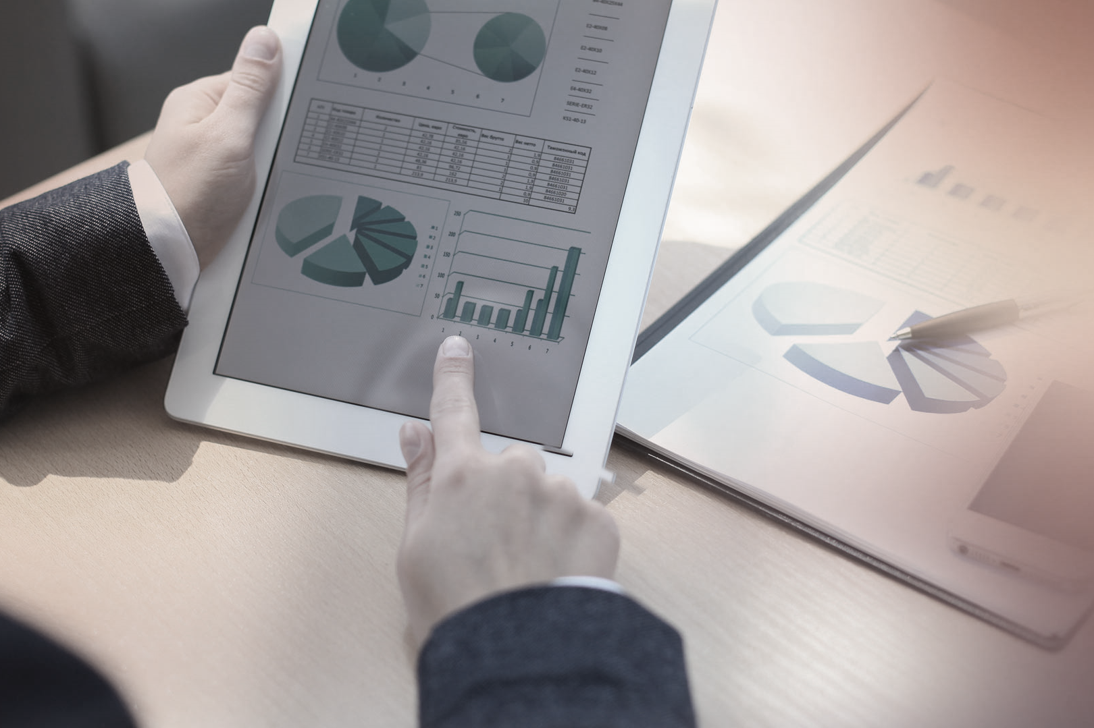
Data Analytics
Checking that the engagement levels meet our expectations:
Engagement based on age rang and nationalities
Adapting the type of trends to the culture of the most viewers
Improving the gaps between the types of viewers (Gender)
Monthly meeting with HOVI to obtain the analytics concerning the advertisement campaign.
Exact numbers of leading potential customers on website
Engagement levels based on social media profiles clicks
Each platform has a Data Analytics

Slide 9

T h a n k Y o u
FOR YOUR ATTENTION

